Slide 1








PYTHON
HACKATON
Team 3

Slide 2
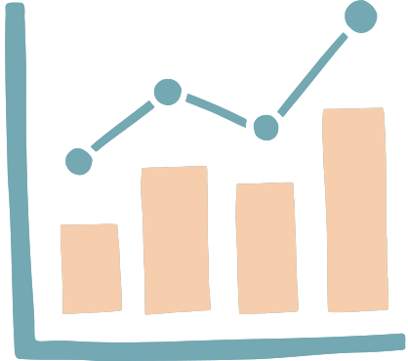


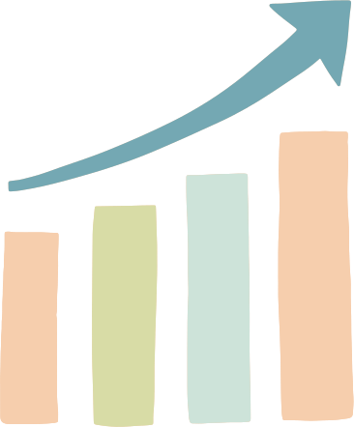
BUILDING OUR CODES
Fixed Hackathon Sample Code
map out data-quality problems and real-world scenario
Update the code and workflow to create clean & consistent data.

Slide 3

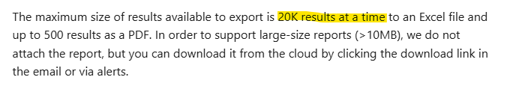

PROBLEM: COMPLEX MULTI-MARKET REPORT
Annual reporting requires handling multiple datasets across brands and markets.
Tasks:
  Create an annual report across multiple markets.
12-month data = multiple export files.
Shoes = multiple brands + multiple market = multiple export searches
= multiple people will export

Slide 4



Manual file transfers
DOWNLOAD
SEND
DOWNLOAD

Slide 5

CHALLENGES IN CURRENT PROCESS
Manual steps create delays, inconsistencies, and risks of errors
01
02
03
Teammates need to send files for central processing
Duplicates appear across different exports
Inconsistent columns across datasets
note: Processing slows as data volume increases

Slide 6

OUR SOLUTION:
AUTOMATED CLOUD-INTEGRATED WORKFLOW

Slide 7






MAXIMISE THE USE OF GDRIVE
Uploading files on cloud will give access to anyone (with the link).
USE OF GOOGLE COLAB
Works like VS Code and Anaconda, but offers the option to mount Google Drive.

Slide 8



SMART DATA INTEGRATION
Direct access to datasets through mounted Google Drive
Folder path with glob code detects and loads all matching files automatically
No need to export, download, and resend files

Slide 9



STANDARDIZED AND RELIABLE DATA
  Define standard columns and drop unnecessary ones
  Add a section for Data Inspection.
  Use df strip to normalise keyword format and mdate to ensure readability of the dates.
  Code to show 5 examples where manual and auto sentiment differ.
  Save duplicates and visualisations to a separate sheet.

Slide 10

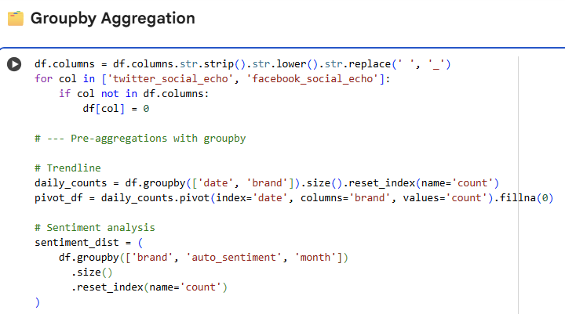
PERFORMANCE OPTIMIZATION
  Chunk processing for efficient data cleaning.
  Group by aggregation for faster trend visualization.

Slide 11
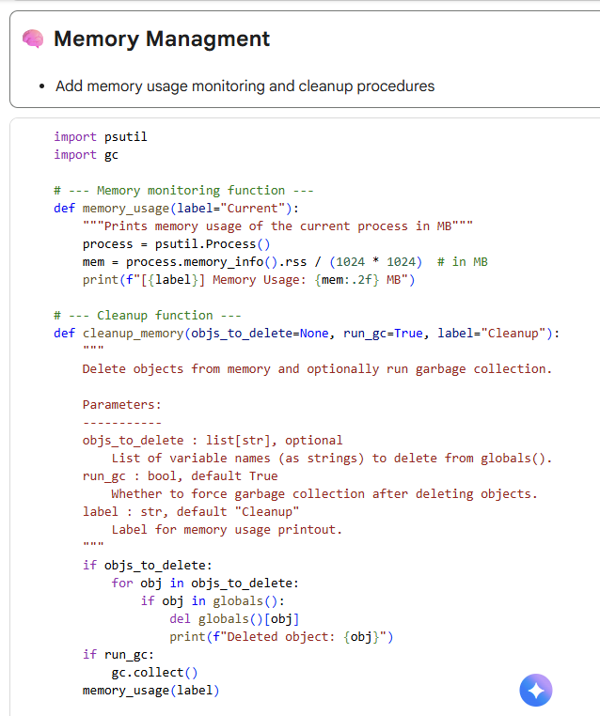
PERFORMANCE OPTIMIZATION
  Memory monitoring and cleanup for large datasets.

Slide 12







DE
MO
Colab File
GDrive Folder

Slide 13


KEY OUTCOMES:
  Eliminated manual file handling and errors
  Produced clean, consistent, and QC-ready datasets
  Automated reporting outputs with visuals included
  Workflow built to handle large, multi-market data

Slide 14
THANK
YOU

